Slide 1
CS F372 Operating Systems
06 – CPU Scheduling-2

Slide 2
Text Book Reading
6.3.5 Multilevel Queue Scheduling
6.3.6 Multilevel Feedback Queue Scheduling

Slide 3
Multilevel Queue
Classify process into different groups
Example: foreground (interactive) & background (batch) processes
Different response time requirements and hence different scheduling needs
Ready queue is partitioned into several separate queues
A process is permanently assigned to a queue based on the property of the process
Memory size, process priority, process type
Each queue has its own scheduling algorithm:
foreground – RR
background – FCFS

Slide 4
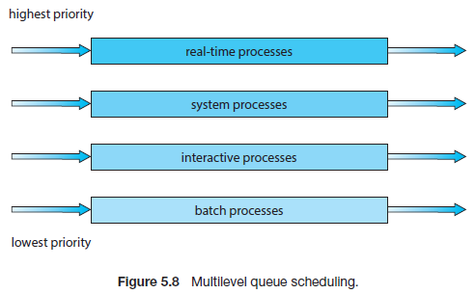
Multilevel Queue
Assume: separate queues for Real-time processes, System processes, Interactive processes, Batch processes

Slide 5
Multilevel Queue
Scheduling among the queues
Fixed-priority preemptive scheduling
Assign priorities to the queue
Real-time processes queue has the highest priority and Batch processes queue has lowest priority
No process in the batch queue, could run unless the queues for real-time processes, system processes, and interactive processes were all empty
If an interactive process entered the ready queue while a batch process was running, the batch process would be preempted
Possibility of starvation

Slide 6
Multilevel Queue
Scheduling among the queues
Time slice among queues
Each queue gets a certain amount of CPU time
This time is used to schedule amongst the processes in that queue
Example: 80% of CPU time to foreground (RR) and 20% of CPU time to background (FCFS)

Slide 7
Multilevel Queue - Example
Consider the following processes using multilevel queue scheduling with two queues. Queue number denotes the queue to which the process is assigned. Let the priority of Queue 1 is greater than the priority of Queue 2. Queue 1 uses Round Robin scheduling with time quantum of 2 ms and Queue 2 uses FCFS scheduling. Use fixed-priority preemptive scheduling to schedule the processes and compute the AWT and ATAT.
Process | Arrival time (ms) | Burst time (ms) | Queue No.
P1 | 0 | 4 | 1
P2 | 0 | 3 | 1
P3 | 0 | 8 | 2
P4 | 10 | 5 | 1

Slide 8
Multilevel Queue - Example
Gantt chart
P1 | P2 | P1 | P2 | P3 | P4 | P4 | P4 | P3
2 | 4 | 6 | 7 | 10 | 12 | 14 | 15 | 20

Slide 9
Multilevel Queue - Example
P1 | P2 | P1 | P2 | P3 | P4 | P4 | P4 | P3
2 | 4 | 6 | 7 | 10 | 12 | 14 | 15 | 20
Process | Arrival time | Burst time | Queue No. | WT | TAT
P1 | 0 | 4 | 1 | 2 | 6
P2 | 0 | 3 | 1 | 2+2 = 4 | 7
P3 | 0 | 8 | 2 | 7+5 = 12 | 20
P4 | 10 | 5 | 1 | 0 | 5
 |  |  |  | AWT = 4.5 | ATAT = 9.5

Slide 10
Multilevel Feedback Queue
A process can move between the various queues
Idea: To separate processes based on CPU-burst time
Process uses too much CPU time – automatically moved to a lower priority queue
I/O bound and interactive processes gets high priority
Processes that are in a lower priority queue for a long time is moved to a higher priority queue
Aging can be implemented this way and prevents starvation
Most general CPU scheduling algorithm

Slide 11
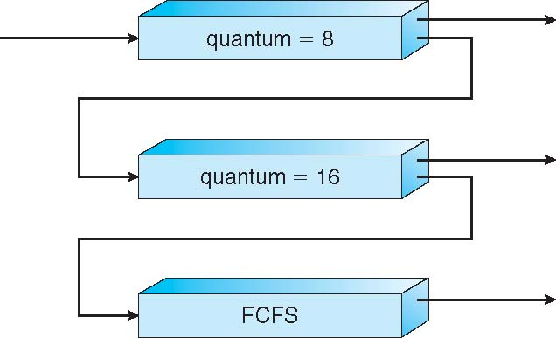
Example of Multilevel Feedback Queue
Queue 0
Three queues:
The scheduler first executes all processes in queue 0
Only when queue 0 is empty will it execute processes in queue 1
Similarly, processes in queue 2 will be executed only if queues 0 and 1 are empty
A process that arrives to queue 1 will preempt a process in queue 2
A process in queue 1 will in turn be preempted by a process arriving for queue 0
Queue 1
Queue 2

Slide 12
Example of Multilevel Feedback Queue
Scheduling
A new job enters queue 0
When it gains CPU, job receives 8 milliseconds
If it does not finish in 8 milliseconds, job is moved to tail of queue 1
At queue 1 job is again served 16 additional milliseconds
If it still does not complete, it is preempted and moved to tail of queue 2

Slide 13
Multilevel Feedback Queue
Multilevel-feedback-queue scheduler defined by the following parameters:
number of queues
scheduling algorithms for each queue
method used to determine when to upgrade a process
method used to determine when to demote a process
method used to determine which queue a process will enter when that process needs service

Slide 14
Multilevel Feedback Queue
Consider the following set of processes with the indicated arrival time. The length of the CPU burst time is given in milliseconds. These processes are scheduled using multilevel feedback queue scheduling with three queues. The first queue Q₀ uses Round Robin scheduling with time quantum of 8msec. The second queue Q₁ uses Round Robin scheduling with a time quantum of 16msec and the last queue Q₂ uses FCFS scheduling. Show the queueing diagram. Draw the Gantt chart, and compute the waiting time of each processes and the average waiting time of processes using this scheduling.

Slide 15
Multilevel Feedback Queue
Process | Arrival time | Burst time
P1 | 0 | 16
P2 | 7 | 9
P3 | 10 | 22
P4 | 15 | 5
P5 | 20 | 40

Slide 16
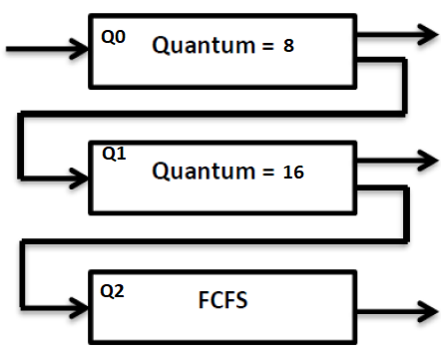
Multilevel Feedback Queue
Queueing diagram

Slide 17
Multilevel Feedback Queue
Process | Arrival time | Burst time
P1 | 0 | 16
P2 | 7 | 9
P3 | 10 | 22
P4 | 15 | 5
P5 | 20 | 40
Gantt chart

Slide 18
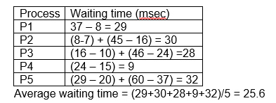
Multilevel Feedback Queue
Process | Arrival time
P1 | 0
P2 | 7
P3 | 10
P4 | 15
P5 | 20

